Slide 1
CMP301 – Computer Networks Lecture week 2
Dr. omar Nibouche

Slide 2
Lecture Week 2
Goal:
Introduction to terminology, further key topics in networking
Introducing communication media
Get ready for laboratory work
Material: gathered, edited and synthesized by Omar
Source:
CCNA: Introduction to Networks
&
Computer Networking: A Top-Down Approach
Overview: What is the Internet?
Media
MAC
Part 1 – key topics
Part 2 – communication media

Slide 3
Part 1 – Further key topics and concepts

Slide 4
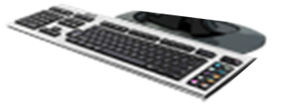
Host: sends packets of data
host sending function:
takes application message
breaks into smaller chunks, known as packets, of length L bits
transmits packet into access network at transmission rate R
link transmission rate, aka link capacity, aka link bandwidth
two packets,
L bits each
2
1
host
R: link transmission rate
packet
transmission
delay
time needed to
transmit L-bit
packet into link
L (bits)
R (bits/sec)
=
=

Slide 5
















packet-switching
packet-switching: hosts break application-layer messages into packets
forward packets from one router to the next, across links on path from source to destination
each packet transmitted at full link capacity
mobile network
national or global ISP
local or regional ISP
home network
content
provider
network
datacenter
network
enterprise
network

Slide 6
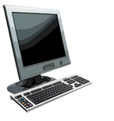
Packet-switching: queueing delay, loss
R = 100 Mb/s
C
A
R = 1.5 Mb/s
D
B
E
queue of packets
waiting for output link
Packet queuing and loss: if arrival rate (in bps) to link exceeds transmission rate (bps) of link for a period of time:
packets will queue, waiting to be transmitted on output link
packets can be dropped (lost) if memory (buffer) in router fills up

Slide 7
Alternative to packet switching: circuit switching
end-end resources allocated to, reserved for “call” between source and destination
in diagram, each link has four circuits.
call gets 2nd circuit in top link and 1st circuit in right link.
dedicated resources: no sharing
circuit-like (guaranteed) performance
circuit segment idle if not used by call (no sharing)
commonly used in traditional telephone networks

Slide 8
Packet switching versus circuit switching
Is packet switching a “slam dunk winner”?
great for “bursty” data – sometimes has data to send, but at other times not
resource sharing
simpler, no call setup
excessive congestion possible: packet delay and loss due to buffer overflow
protocols needed for reliable data transfer, congestion control
Q: How to provide circuit-like behavior?
bandwidth guarantees traditionally used for audio/video applications
Q: human analogies of reserved resources (circuit switching) versus on-demand allocation (packet switching)?

Slide 9
How do packet loss and delay occur?
packets queue in router buffers
packets queue, wait for turn
arrival rate to link (temporarily) exceeds output link capacity: packet loss
packet being transmitted (transmission delay)
A
B
packets in buffers (queueing delay)
free (available) buffers: arriving packets
dropped (loss) if no free buffers

Slide 10
Packet loss
queue (aka buffer) preceding link in buffer has finite capacity
packet arriving to full queue dropped (aka lost)
lost packet may be retransmitted by previous node, by source end system, or not at all
buffer
(waiting area)
A
packet being transmitted
B
packet arriving to
full buffer is lost
* Check out the Java applet for an interactive animation on queuing and loss

Slide 11
Network security
field of network security:
how bad guys can attack computer networks
how we can defend networks against attacks
how to design architectures that are immune to attacks
Internet not originally designed with (much) security in mind
original vision: “a group of mutually trusting users attached to a transparent network” ☺
Internet protocol designers playing “catch-up”
security considerations in all layers!

Slide 12
Bad guys: malware
malware can get in host from:
virus: self-replicating infection by receiving/executing object (e.g., e-mail attachment)
worm: self-replicating infection by passively receiving object that gets itself executed
spyware malware can record keystrokes, web sites visited, upload info to collection site
infected host can be enrolled in botnet, used for spam or distributed denial of service (DDoS) attacks

Slide 13
Bad guys: denial of service
Denial of Service (DoS): attackers make resources (server, bandwidth) unavailable to legitimate traffic by overwhelming resource with bogus traffic
1. select target
2. break into hosts around the network (see botnet)
3. send packets to target from compromised hosts
target

Slide 14

Bad guys: packet interception
packet “sniffing”:
broadcast media (shared Ethernet, wireless)
promiscuous network interface reads/records all packets (e.g., including passwords!) passing by
A
C
src:B dest:A payload
B
Wireshark software used for our end-of-chapter labs is a (free) packet-sniffer

Slide 15
Bad guys: fake identity
IP spoofing: send packet with false source address
A
C
src:B dest:A payload
B
… lots more on security (throughout, Chapter 8)

Slide 16
Part 2 – Media

Slide 17
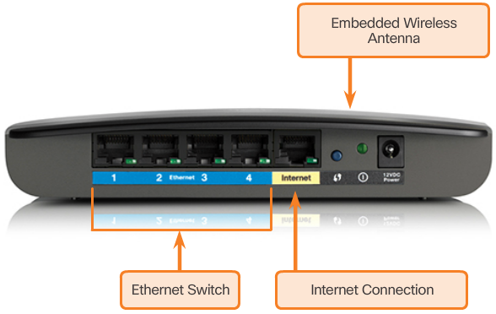
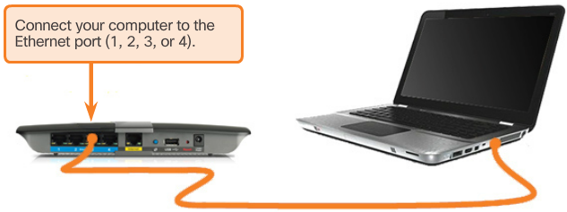
Types of Connections
Home Router
Connecting to the Wired LAN
Notes:
A physical connection can be a wired connection using a cable or a wireless connection using radio waves.
The type of physical connection used is dependent upon the setup of the network.
To offer wireless capability, devices on a wireless network must be connected to a wireless access point (AP).
Switch devices and wireless access points are often two separate dedicated devices within a network implementation. However, there are also devices that offer both wired and wireless connectivity.

Slide 18
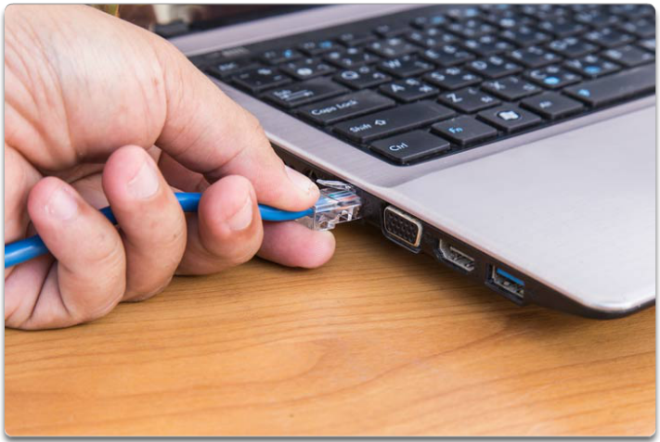
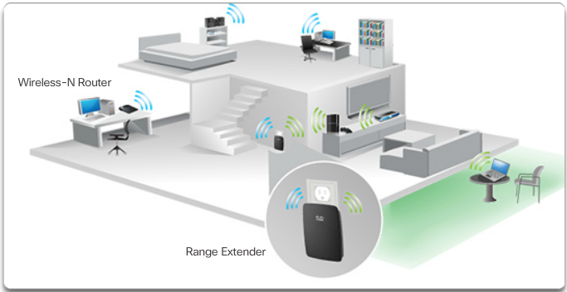
Network Interface Card (NIC)
Wired Connection Using an Ethernet NIC
Connecting to the Wireless LAN with Range Extender
Notes:
Network Interface Cards (NICs) connect a device to the network.
Ethernet NICs are used for a wired connection, whereas WLAN (Wireless Local Area Network) NICs are used for wireless.
An end-user device may include one or both types of NICs.
Not all physical connections are equal, in terms of the performance level, when connecting to a network.
For example, a wireless device will experience degradation in performance based on its distance from a wireless access point. The further the device is from the access point, the weaker the wireless signal it receives. This can mean less bandwidth or no wireless connection at all. Alternatively, a wired connection will not degrade in performance.

Slide 19
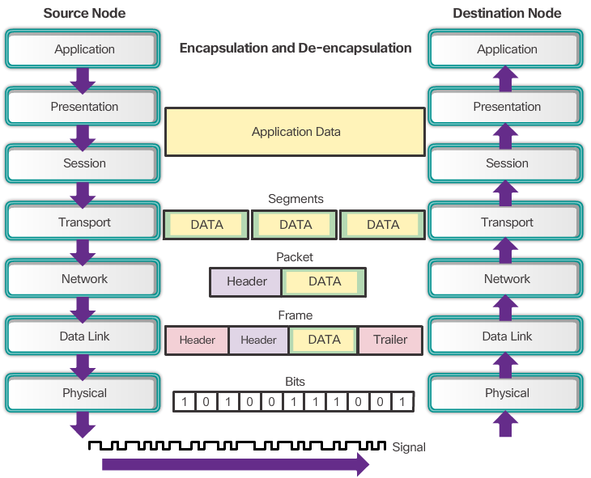
The Physical Layer
Notes:
The OSI physical layer provides the means to transport the bits that make up a data link layer frame across the network media. This layer accepts a complete frame from the data link layer and encodes it as a series of signals that are transmitted onto the local media.
The physical layer encodes the frames and creates the electrical, optical, or radio wave signals that represent the bits in each frame.
These signals are then sent on the media, one at a time.
The destination node physical layer retrieves these individual signals from the media, restores them to their bit representations, and passes the bits up to the data link layer as a complete frame.

Slide 20
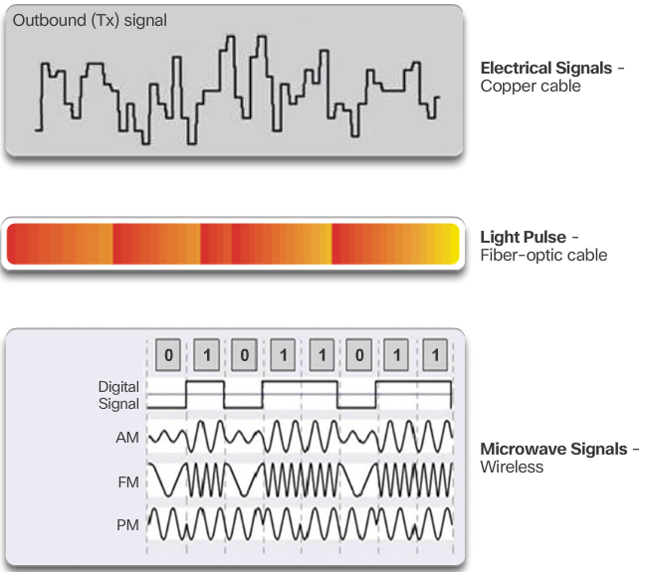
Physical Layer Media
Notes:
There are three basic forms of network media. The physical layer produces the representation and groupings of bits for each type of media as:
Copper cable: The signals are patterns of electrical pulses.
Fiber-optic cable: The signals are patterns of light.
Wireless: The signals are patterns of microwave transmissions.

Slide 21
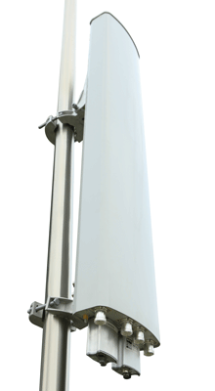
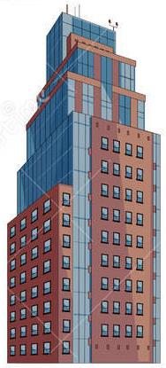
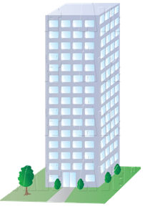
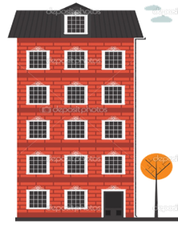
Multipath / Penetration Loss / Knife-edge Diffraction / Reflection
Penetration Loss
Penetration Loss – This is the loss (attenuation) which a radio signal suffers as it passes through a material. For example, when a radio wave passes through walls in an office building. The loss is measured in dB and the attenuation factor (level of loss) will be depended upon the type of material which the wave passes through.
Multipath
Multipath results when radio waves find several individual paths to take when propagating between transmitter and receiver. When the signals arrive, via different paths, at the receiver they can add and subtract in strength to cause fading of the received signal.
Base stations
Knife-edge Diffraction
Knife-edge Diffraction – This is a phenomenon whereby radio waves travelling in a straight path bend around an obstacle. It explains why radio reception can be sometimes achieved behind a large building or mountain. The area not covered by diffraction is called the shadow zone.
Reflection
Reflection – Just a light waves are reflected by a mirror, radio waves are reflected by any conductive medium such as metal or the earth’s surface.
Knife-Edge
Diffraction, Scattering
Penetration Loss
Reflection
Shadow – No Signal

Slide 22
Multipath
Multipath
Multipath results when radio waves find several individual paths to take when propagating between transmitter and receiver. When the signals arrive, via different paths, at the receiver they can add and subtract in strength to cause fading of the received signal.
Penetration Loss
Penetration Loss – This is the loss (attenuation) which a radio signal suffers as it passes through a material. For example, when a radio wave passes through walls in an office building. The loss is measured in dB and the attenuation factor (level of loss) will be depended upon the type of material which the wave passes through.
Knife-edge Diffraction
Knife-edge Diffraction – This is a phenomenon whereby radio waves travelling in a straight path bend around an obstacle. It explains why radio reception can be sometimes achieved behind a large building or mountain. The area not covered by diffraction is called the shadow zone.
Reflection
Reflection – Just a light waves are reflected by a mirror, radio waves are reflected by any conductive medium such as metal or the earth’s surface.

Slide 23
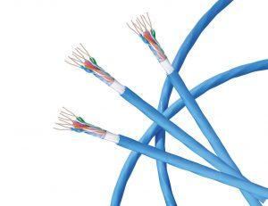
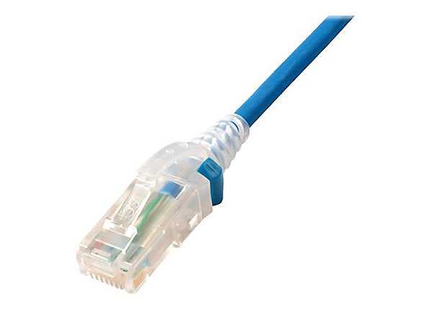
Links: physical media
bit: propagates between transmitter/receiver pairs
physical link: what lies between transmitter & receiver
guided media:
signals propagate in solid media: copper, fiber, coax
unguided media:
signals propagate freely, e.g., radio
Twisted pair (TP)
two insulated copper wires
Category 5: 100 Mbps, 1 Gbps Ethernet
Category 6: 10Gbps Ethernet

Slide 24
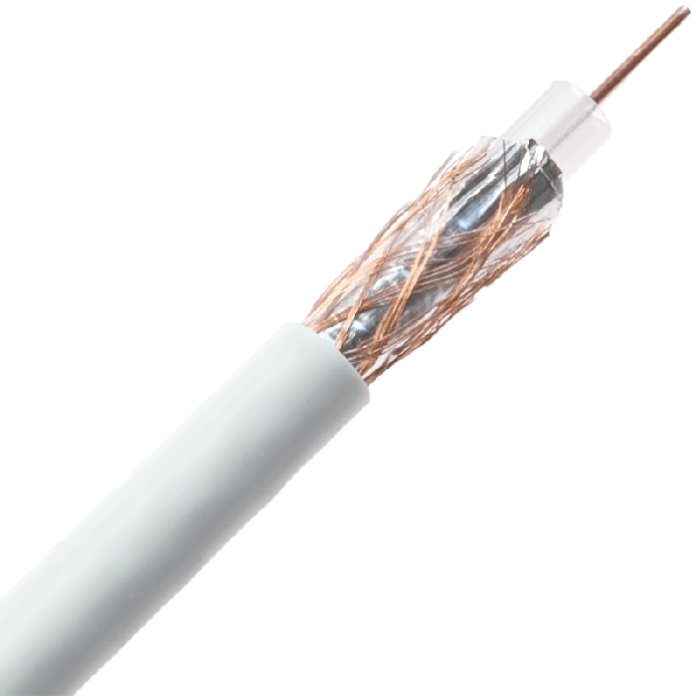
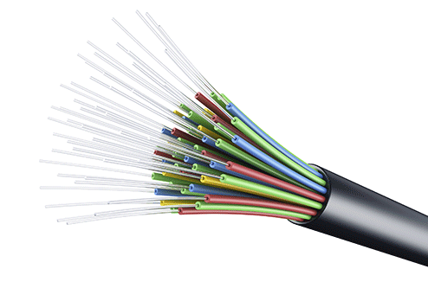
Links: physical media
Coaxial cable:
two concentric copper conductors
bidirectional
broadband:
multiple frequency channels on cable
100’s Mbps per channel
Fiber optic cable:
glass fiber carrying light pulses, each pulse a bit
high-speed operation:
high-speed point-to-point transmission (10’s-100’s Gbps)
low error rate:
repeaters spaced far apart
immune to electromagnetic noise

Slide 25
Links: physical media
Wireless radio
signal carried in electromagnetic spectrum
no physical “wire”
broadcast and “half-duplex” (sender to receiver)
propagation environment effects:
reflection
obstruction by objects
interference
Radio link types:
terrestrial microwave
up to 45 Mbps channels
Wireless LAN (WiFi)
Up to 100’s Mbps
wide-area (e.g., cellular)
4G cellular: ~ 10’s Mbps
satellite
up to 45 Mbps per channel
270 msec end-end delay
geosynchronous versus low-earth-orbit

Slide 26
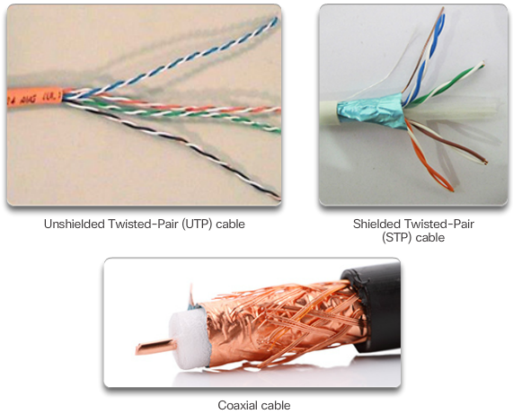
Copper Media and Characteristics
Copper Cabling
Notes:
Networks use copper media because it is inexpensive, easy to install, and has low resistance to electrical current. However, copper media is limited by distance and signal interference.
Data is transmitted on copper cables as electrical pulses. A detector in the network interface of a destination device must receive a signal that can be successfully decoded to match the signal sent. However, the longer the signal travels, the more it deteriorates. This is referred to as signal attenuation.
The timing and voltage values of the electrical pulses are also susceptible to interference from two sources:
Electromagnetic interference (EMI) or radio frequency interference (RFI) - EMI and RFI signals can distort and corrupt the data signals being carried by copper media. Potential sources of EMI and RFI include radio waves and electromagnetic devices, such as fluorescent lights or electric motors.
Crosstalk - Crosstalk is a disturbance caused by the electric or magnetic fields of a signal on one wire to the signal in an adjacent wire. In telephone circuits, crosstalk can result in hearing part of another voice conversation from an adjacent circuit. Specifically, when an electrical current flows through a wire, it creates a small, circular magnetic field around the wire, which can be picked up by an adjacent wire.
To counter the negative effects of crosstalk, some types of copper cables have opposing circuit wire pairs twisted together, which effectively cancels the crosstalk.
There are three main types of copper media used in networking:
Unshielded Twisted-Pair (UTP)
Shielded Twisted-Pair (STP)
Coaxial
These cables are used to interconnect nodes on a LAN and infrastructure devices such as switches, routers, and wireless access points. Each type of connection and the accompanying devices has cabling requirements stipulated by physical layer standards.

Slide 27
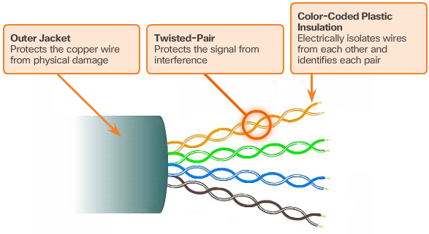
Unshielded Twisted-Pair Cable
Notes:
Unshielded twisted-pair (UTP) cabling is the most common networking media.
In LANs, UTP cable consists of four pairs of color-coded wires that have been twisted together and then encased in a flexible plastic sheath that protects from minor physical damage
UTP cable does not use shielding to counter the effects of EMI and RFI. Instead, cable designers have discovered that they can limit the negative effect of crosstalk by:
Cancellation: Designers now pair wires in a circuit. When two wires in an electrical circuit are placed close together, their magnetic fields are the exact opposite of each other. Therefore, the two magnetic fields cancel each other and also cancel out any outside EMI and RFI signals.
UTP cable relies solely on the cancellation effect produced by the twisted wire pairs to limit signal degradation and effectively provide self-shielding for wire pairs within the network media.

Slide 28
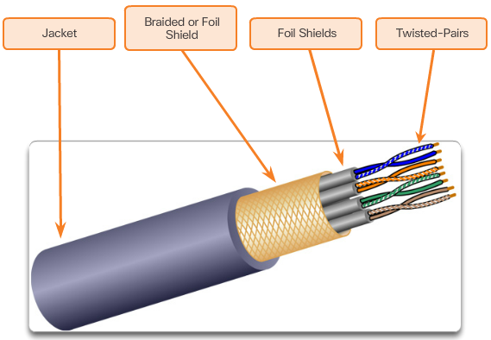
Shielded Twisted-Pair Cable
Notes:
Shielded twisted-pair (STP) provides better noise protection than UTP cabling. However, compared to UTP cable, STP cable is significantly more expensive and difficult to install. STP cables combine the techniques of shielding to counter EMI and RFI, and wire twisting to counter crosstalk.

Slide 29
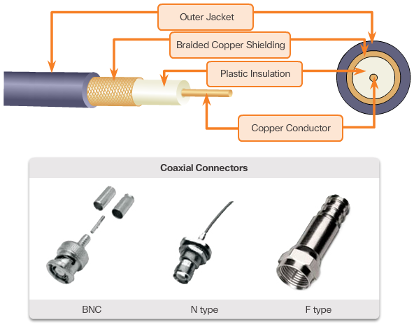
Coaxial Cable
Notes:
Coaxial cable, or coax for short, gets its name from the fact that there are two conductors that share the same axis. As shown in the figure, coaxial cable consists of:
A copper conductor used to transmit the electronic signals.
A layer of flexible plastic insulation surrounding a copper conductor.
The insulating material is surrounded in a woven copper braid, or metallic foil, that acts as the second wire in the circuit and as a shield for the inner conductor. This second layer, or shield, also reduces the amount of outside electromagnetic interference.
The entire cable is covered with a cable jacket to prevent minor physical damage.
Although UTP cable has essentially replaced coaxial cable in modern Ethernet installations, the coaxial cable design is used in:
Wireless installations: Coaxial cables attach antennas to wireless devices. The coaxial cable carries radio frequency (RF) energy between the antennas and the radio equipment.
Cable Internet installations: Cable service providers provide Internet connectivity to their customers by replacing portions of the coaxial cable and supporting amplification elements with fiber-optic cable. However, the wiring inside the customer's premises is still coax cable.

Slide 30
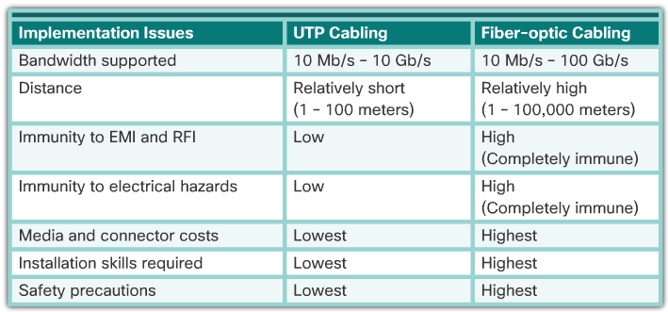
Fiber versus Copper
Notes:
Optical fiber cable transmits data over longer distances and at higher bandwidths than any other networking media. Unlike copper wires, fiber-optic cable can transmit signals with less attenuation and is completely immune to EMI and RFI. Optical fiber is commonly used to interconnect network devices.
Optical fiber is a flexible, but extremely thin, transparent strand of very pure glass, not much bigger than a human hair. Bits are encoded on the fiber as light impulses. The fiber-optic cable acts as a waveguide, or “light pipe,” to transmit light between the two ends with minimal loss of signal.
There are many advantages to using fiber-optic cable compared to copper cables: the media is immune to electromagnetic interference and will not conduct unwanted electrical currents due to grounding issues. Optical fibers are thin and have a relatively low signal loss and can be operated at much greater lengths than copper media. Some optical fiber physical layer specifications allow lengths that can reach multiple kilometers.

Slide 31
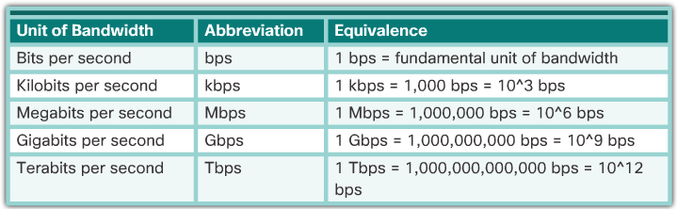
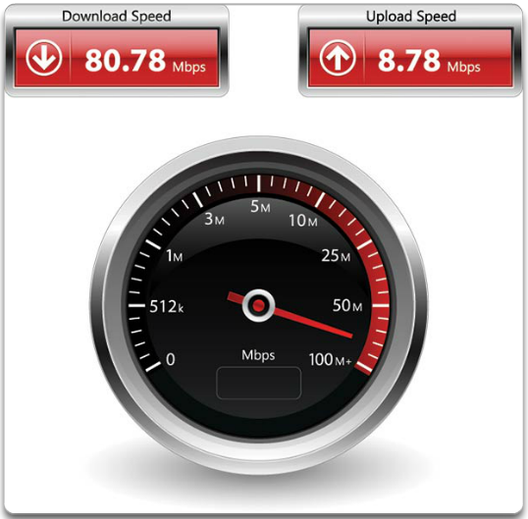
Bandwidth
Throughput
Notes:
Different physical media support the transfer of bits at different rates. Data transfer is usually discussed in terms of bandwidth and throughput.
Bandwidth is the capacity of a medium to carry data. Digital bandwidth measures the amount of data that can flow from one place to another in a given amount of time. Bandwidth is typically measured in kilobits per second (kb/s), megabits per second (Mb/s), or gigabits per second (Gb/s).
A combination of factors determines the practical bandwidth of a network:
The properties of the physical media
The technologies chosen for signaling and detecting network signals
Throughput is the measure of the transfer of bits across the media over a given period of time.
Throughput does not match the specified bandwidth in physical layer implementations. Many factors influence throughput, including:
The amount of traffic
The type of traffic
The latency created by the number of network devices encountered between source and destination
Throughput cannot be faster than the slowest link in the path from source to destination.

Slide 32
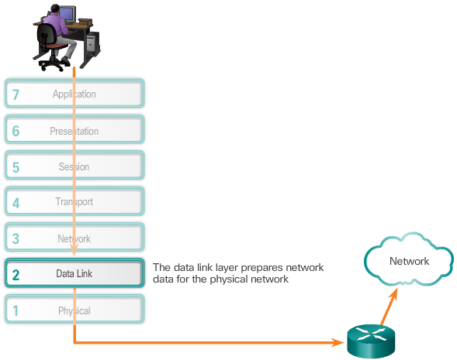
The Data Link Layer
Notes:
The data link layer of the OSI model (Layer 2) is responsible for:
Allowing the upper layers to access the media
Accepting Layer 3 packets and packaging them into frames
Preparing network data for the physical network
Controlling how data is placed and received on the media
Exchanging frames between nodes over a physical network media, such as UTP or fiber-optic
Receiving and directing packets to an upper layer protocol
Performing error detection
The Layer 2 notation for network devices connected to a common media is called a node. Nodes build and forward frames.
The data link layer effectively separates the media transitions that occur as the packet is forwarded from the communication processes of the higher layers. The data link layer receives packets from and directs packets to an upper layer protocol, in this case IPv4 or IPv6. This upper layer protocol does not need to be aware of which media the communication will use.

Slide 33
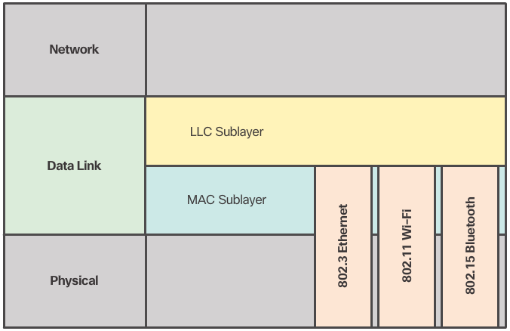
Data Link Sublayers
Notes:
The data link layer is divided into two sublayers:
Logical Link Control (LLC) - This upper sublayer communicates with the network layer. It places information in the frame that identifies which network layer protocol is being used for the frame. This information allows multiple Layer 3 protocols, such as IPv4 and IPv6, to utilize the same network interface and media.
Media Access Control (MAC) - This lower sublayer defines the media access processes performed by the hardware. It provides data link layer addressing and access to various network technologies. For instance, the MAC sublayer communicates with Ethernet LAN technology to send and receive frames over copper or fiber-optic cable. The MAC sublayer also communicates with wireless technologies such as Wi-Fi and Bluetooth to send and receive frames wirelessly.

Slide 34
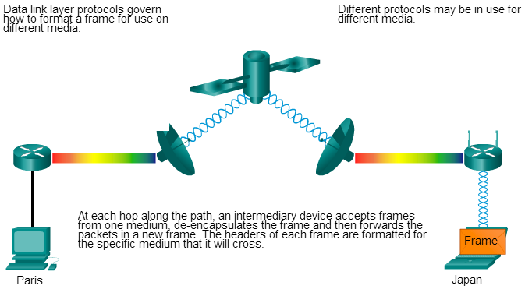
Media Access Control
Notes:
Layer 2 protocols specify the encapsulation of a packet into a frame and the techniques for getting the encapsulated packet on and off each medium.
The technique used for getting the frame on and off the media is called the media access control method.
As packets travel from the source host to the destination host, they typically traverse over different physical networks. These physical networks can consist of different types of physical media such as copper wires, optical fibers, and wireless consisting of electromagnetic signals, radio and microwave frequencies, and satellite links.
Without the data link layer, network layer protocols such as IP, would have to make provisions for connecting to every type of media that could exist along a delivery path. Moreover, IP would have to adapt every time a new network technology or medium was developed. This process would hamper protocol and network media innovation and development. This is a key reason for using a layered approach to networking.
Different media access control methods may be required during a single communication. Each network environment that packets encounter as they travel from a local host to a remote host can have different characteristics. For example, an Ethernet LAN consists of many hosts contending to access the network medium. Serial links consist of a direct connection between only two devices.
Router interfaces encapsulate the packet into the appropriate frame, and a suitable media access control method is used to access each link. In any given exchange of network layer packets, there may be numerous data link layers and media transitions.
At each hop along the path, a router:
Accepts a frame from a medium
De-encapsulates the frame
Re-encapsulates the packet into a new frame
Forwards the new frame appropriate to the medium of that segment of the physical network

Slide 35
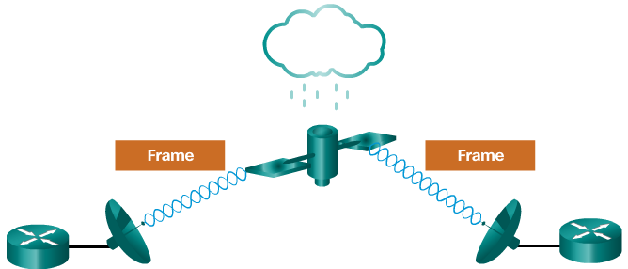
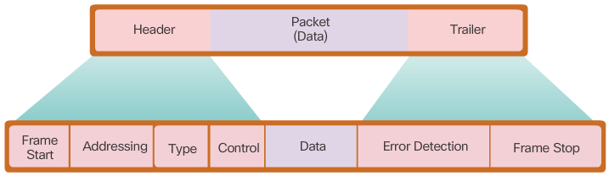
The Frame
Frames have three basic parts:
Header
Data
Trailer
Notes:
The data link layer prepares a packet for transport across the local media by encapsulating it with a header and a trailer to create a frame. The description of a frame is a key element of each data link layer protocol. Although there are many different data link layer protocols that describe data link layer frames, each frame type has three basic parts:
Header
Data
Trailer
All data link layer protocols encapsulate the Layer 3 PDU within the data field of the frame. However, the structure of the frame and the fields contained in the header and trailer vary according to the protocol.
Framing breaks the stream into decipherable groupings, with control information inserted in the header and trailer as values in different fields. This format gives the physical signals a structure that can be received by nodes and decoded into packets at the destination.
Generic frame field types include:
Frame start and stop indicator flags - Used to identify the beginning and end limits of the frame.
Addressing - Indicates the source and destination nodes on the media.
Type - Identifies the Layer 3 protocol in the data field.
Control - Identifies special flow control services such as quality of service (QoS)
Data - Contains the frame payload (i.e., packet header, segment header, and the data).
Error Detection - These frame fields are used for error detection and are included after the data to form the trailer.
Not all protocols include all of these fields. The standards for a specific data link protocol define the actual frame format.
Data link layer protocols add a trailer to the end of each frame. The trailer is used to determine if the frame arrived without error. This process is called error detection and is accomplished by placing a logical or mathematical summary of the bits that comprise the frame in the trailer.

Slide 36
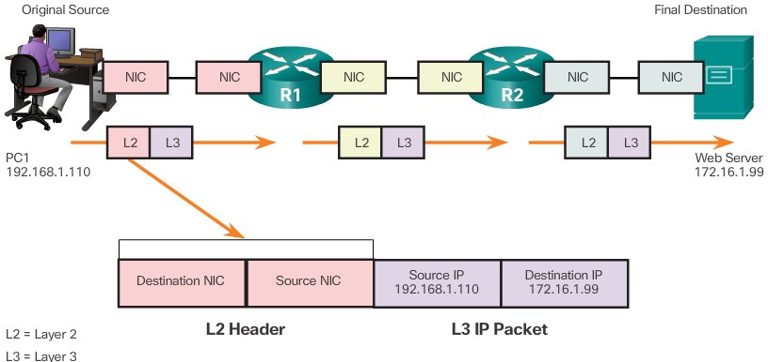
Layer 2 Address
Notes:
The data link layer provides physical addressing that is used in transporting a frame across a shared local media.
Data link layer addressing is contained within the frame header and specifies the frame destination node on the local network. The frame header may also contain the source address of the frame.
Unlike Layer 3 logical addresses, which are hierarchical, physical addresses do not indicate on what network the device is located. Rather, the physical address is unique to the specific device.
In the example: as the IP packet travels from host-to-router, router-to-router, and finally router-to-host, at each point along the way the IP packet is encapsulated in a new data link frame. Each data link frame contains the source data link address of the NIC card sending the frame, and the destination data link address of the NIC card receiving the frame.

Slide 37
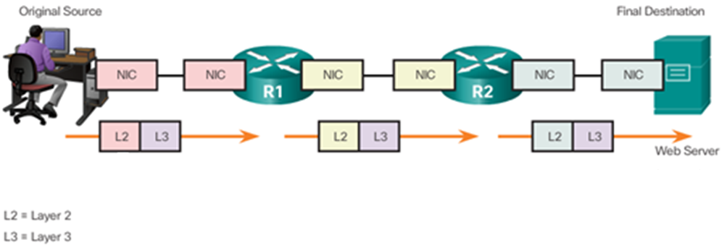
Example : L2 and L3 networking parameters (which is part of L2 and L3 headers) (1)
Refer to the exhibit: L2 and L3 refer to the OSI model layers; the coloured rectangles in the exhibit refer to the networking parameters in the headers of those layers. NIC is a Network Interface Card. To simplify the exercise, switches are omitted. All nodes are supposed to know the IPs and MACs of all involved parties. MAC addresses are shown using 4 digits only (a MAC address is 48 bits though)

Slide 38
L2 and L3 networking parameters (which is part of L2 and L3 headers) (2)
In our topology, PC1 connects to router R1 using a fast Ethernet interface:
PC1 MAC: 0A:10
PC1 IP: 192.168.1.10
R1 MAC (on that particular interface): 0C:03
R1 IP: 192.168.1.1
R1 connects to R2 using a fast Ethernet link; on such interface we have the following addresses:
R1 MAC: 0C:04
R1 IP: 192.168.3.1
R2 MAC (on that particular interface): 0D:05
R2 IP: 192.168.3.2

Slide 39
L2 and L3 networking parameters (which is part of L2 and L3 headers) (3)
R2 connects to the server using another fast Ethernet link; on such interface we have the following addresses:
R2 MAC (on that particular interface): 0D:06
R2 IP: 192.168.4.1
Server MAC: 0F:08
Server IP: 192.168.4.10
The headers of L2 and L3 should show (among other things), the destination and source MAC and IP addresses.
The exercise is simplified in the sense that routers may have different ways/means (links) of communication.
Our scenario is that PC1 wants to send data to the server; show how the L2 and L3 headers would change their content:

Slide 40
L2 and L3 networking parameters (which is part of L2 and L3 headers) (4)
From PC1 to server | L2 source MAC address | L2 destination MAC address | L3 source IP address | L3 destination IP address
PC1 to R1 | 0A:10 | 0C:03 | 192.168.1.10 | 192.168.4.10
R1 to R2 | 0C:04 | 0D:05 | 192.168.1.10 | 192.168.4.10
R2 to server | 0D:06 | 0F:08 | 192.168.1.10 | 192.168.4.10

